Slide 1
Cluster Analysis Of DRG
Summary Of Analysis Methods And Hypotheses
MDC v.s. Clusters
Service Category v.s. Clusters
CCSPXGRP v.s. Clusters
Conclusion
HS 256 Group 4:
Ruosi Liu, Qingyue Su, Yuan Tian,
Hsiang-Yao Tsai, Chuyue Wu, Pengcheng Xu

Slide 2
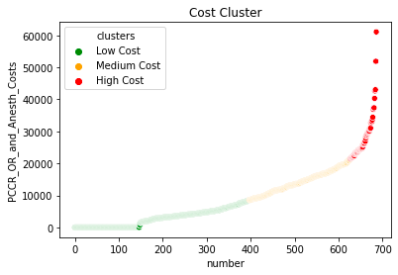
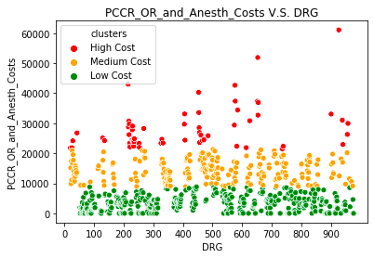
Clustering Method: Scikit Learn K-Means Clustering on Operation and Anesthesia cost.
Methods Of Interpretation: 1. Distribution of cost clusters in each MDC
2. Procedures v.s. non-procedures (medical v.s. surgical)
3. Distribution in each Principle Procedure High Level Group
4. MCC/CC v.s. without MCC/CC

Slide 3
MDC Categories VS Clusters(High Cost Ratio)
Expensive Surgeries Involved In These Categories:
Bypass surgeries: endoscopic in liver or pancreas or coronary arteries (CABG)
Implant: spinal Fusion, CABG
Transplant: kidney transplant
Cancer: uterine and ovary cancer, breast cancer
Burns
Trauma
Skin graft
Notes:
We will select high cost MDC types and take a closer look at the types of DRG
And find common points among them. We find that most of the high-cost surgeries are precision surgerys or surgeries that require implanted devices.
Let’s take a closer look into the categories.
First, the bypass surgeries using endoscopic, which will be complex surgeries with high risk.
The bypass surgeries in heart is one of the highest risk procedure sometimes requires implant stent.

Slide 4
MDC Categories VS Clusters(High Cost Ratio)
Common properties:
Expensive implants: several hundred thousand for an implanted device
Complicated procedure: requires extreme attention to details and high precision
Long and exhaustive process: takes a great amount of time
High infection risk: Cause infection and complication

Slide 5
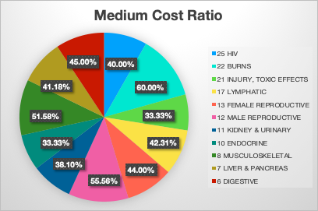
MDC Categories VS Clusters(Medium Cost Ratio)
Medium Surgeries Involved In These Categories:
Procedures for not severe diseases or minor procedures (Few implant):
Non-extensive burns; Musculoskeletal; Lymphatic
Common surgeries with mature skills:
Digestive, Endocrine, Liver & Pancreas,
Kidney & Urinary
Sex-related surgeries:
male reproductive, female reproductive
Chronic Diseases: HIV
Others (No operations):
Wound debridements for injuries, Toxic effects
Notes:
In medium cost cluster, we concentrates on 11 MDC categories. For each category, we analyzed the types of DRG and make comparisons.
In MDC7,unlike high cost cluster that
MDC 10 includes some endocrine diseases like obesity, Thyroid, parathyroid, nutrit & metab.
MDC 11

Slide 6
MDC Categories VS Clusters(Low Cost Ratio)
Interesting Observations:
All categories have a large low cost ratio
Operations not needed or minor surgeries suffice, unless crazy thing happens
Mental illness, substance abuse, pregnancy and neonatal...
Consultation of physicians for the most part
Disorder, infection, seizures, disease, and asthma...
If operation needed, probably labelled by another DRG Group with procedure within same MDC category

Slide 7
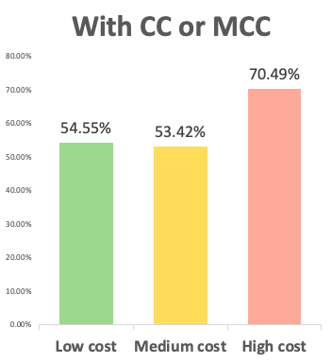
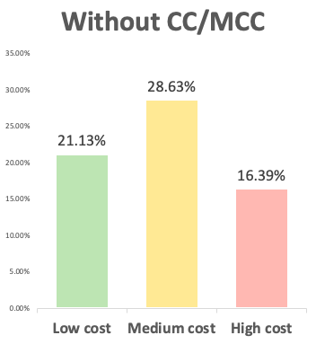
MCC/CC(complication or comorbidity) VS Cluster
Calculate percentage of with CC or MCC v.s. without in each cost category
DRGs with complication or comorbidity are more likely to cost highly in operation and anesthesia.
With CC or MCC: with major complication or comorbidity or complication or comorbidity
Without CC/MCC: without major complication or comorbidity and complication or comorbidity

Slide 8
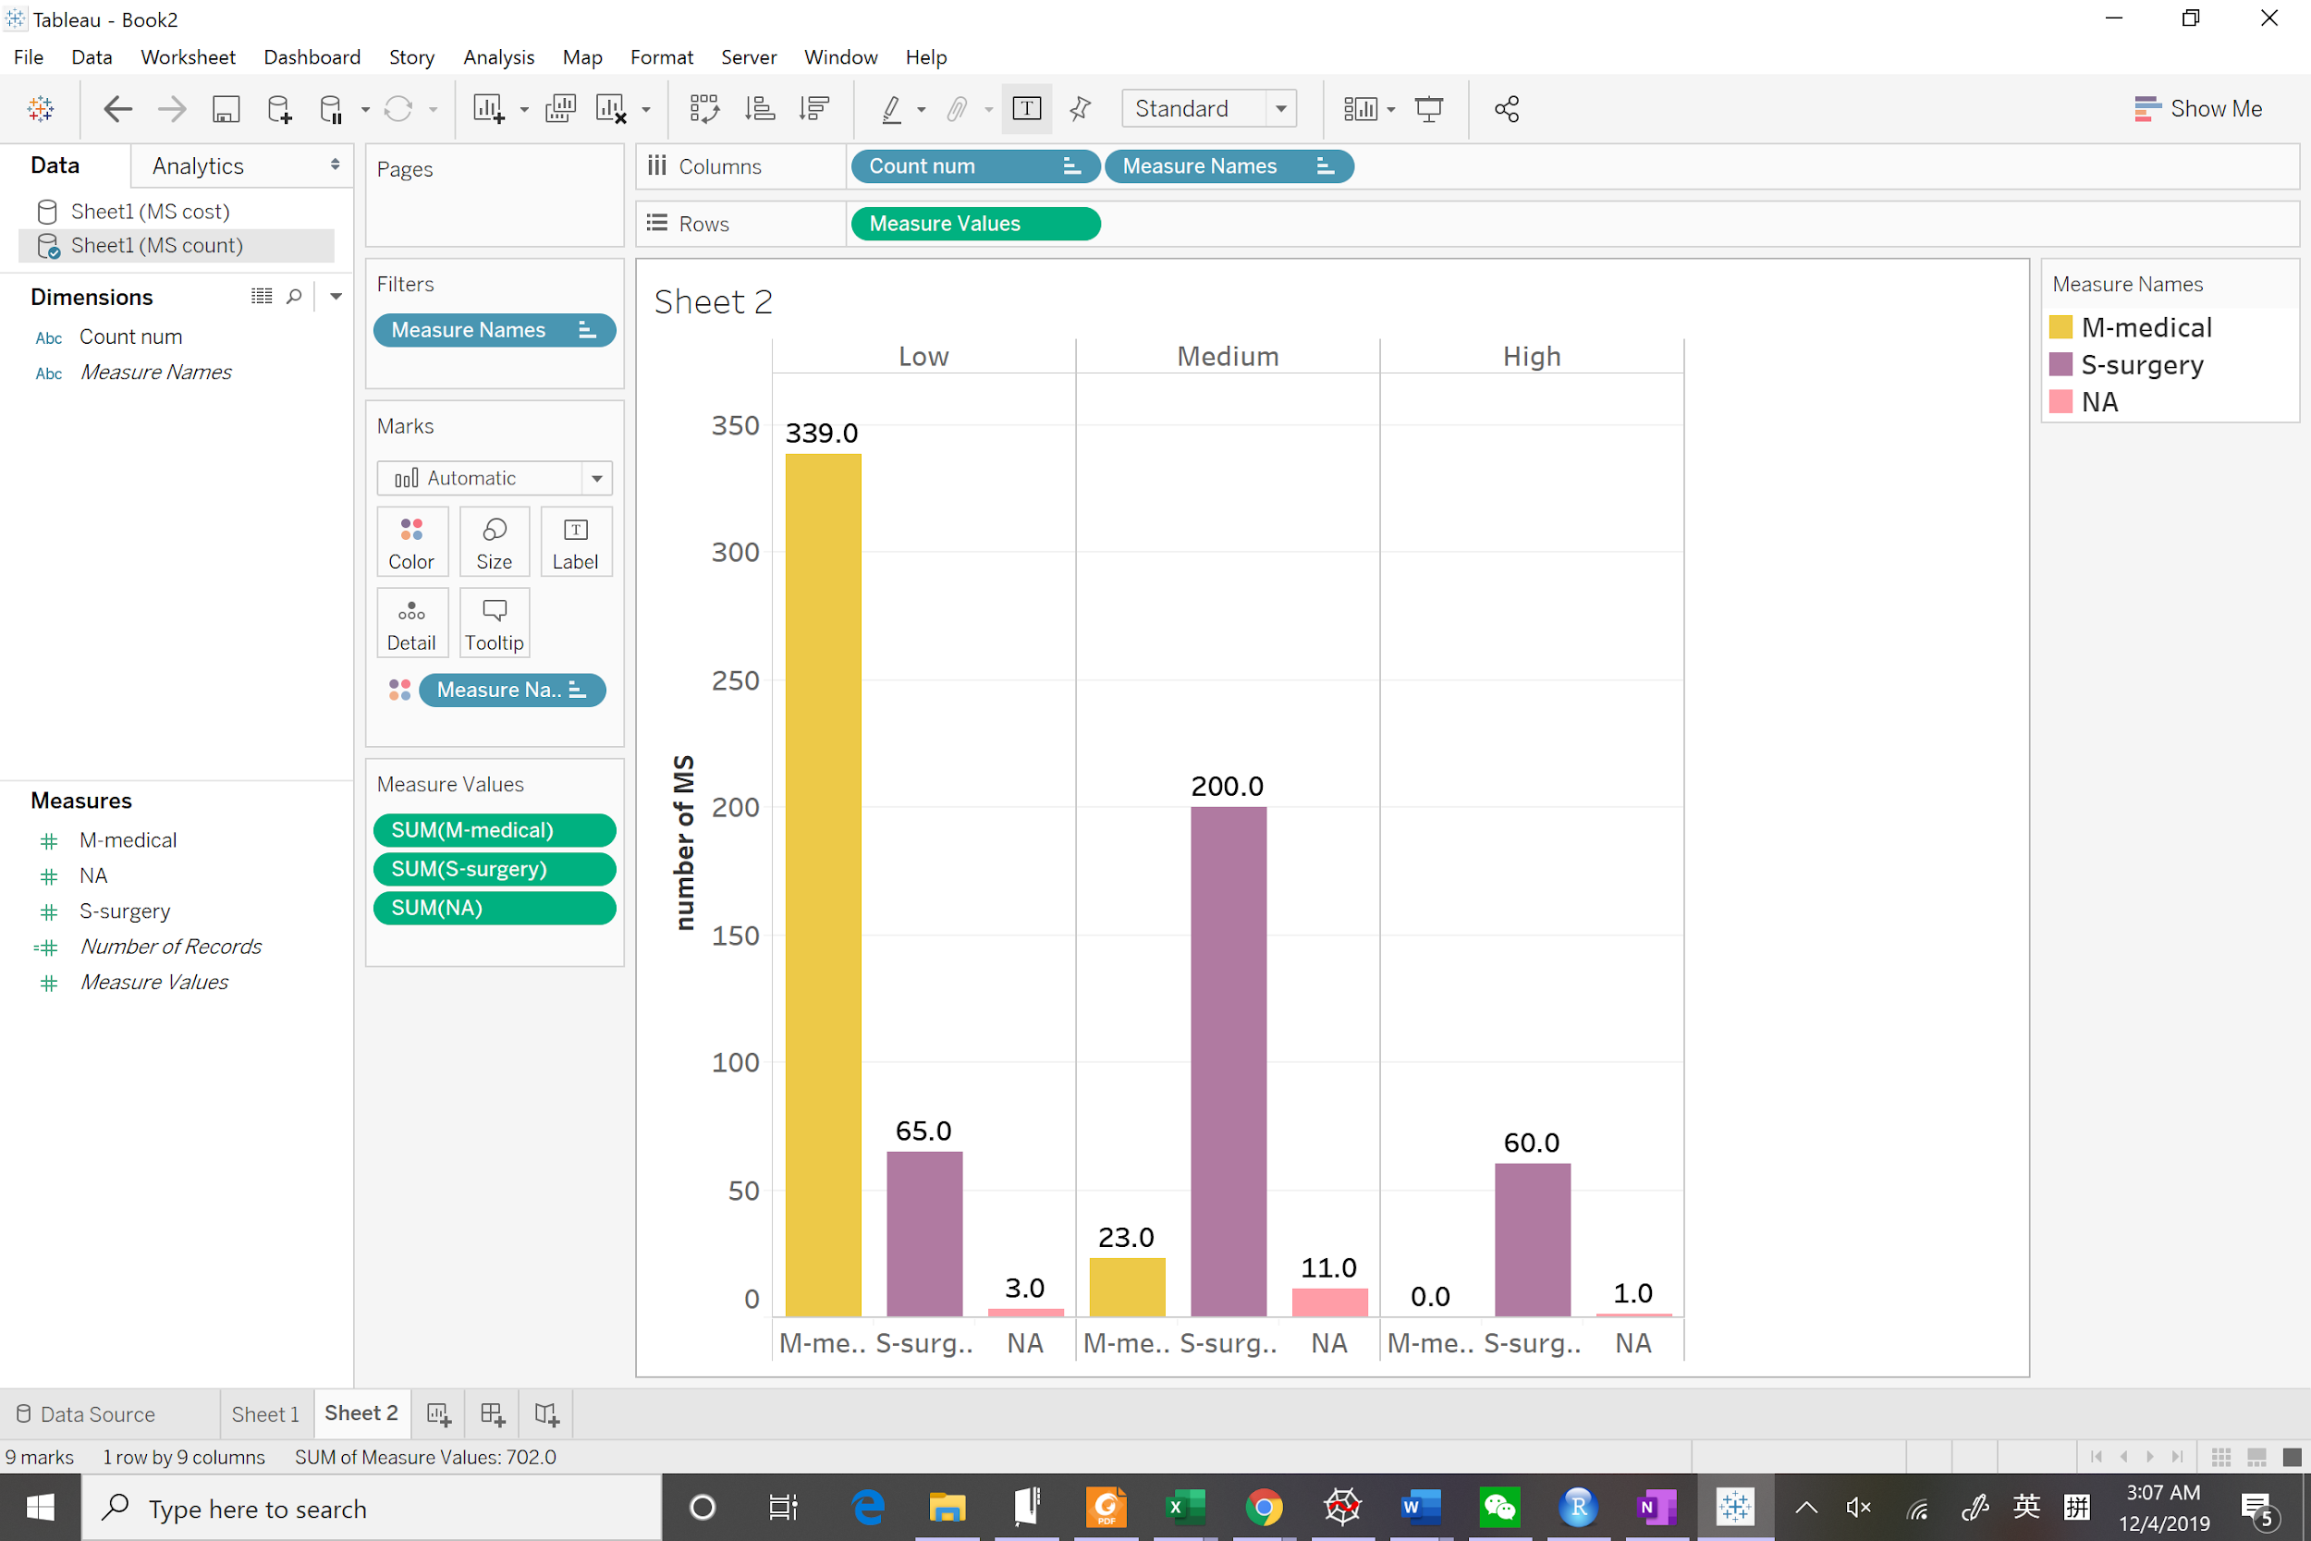
Service categories(Medical or Surgery) VS Clusters
The number of Medical service makes up most of Low-cost cluster
200 out of 234 DRGs are surgery service-type in Medium-cost cluster
No medical service occur in High cost group
Low-cost → High-cost cluster
# of Medical services ⬇
# of Surgery services ⬆

Slide 9
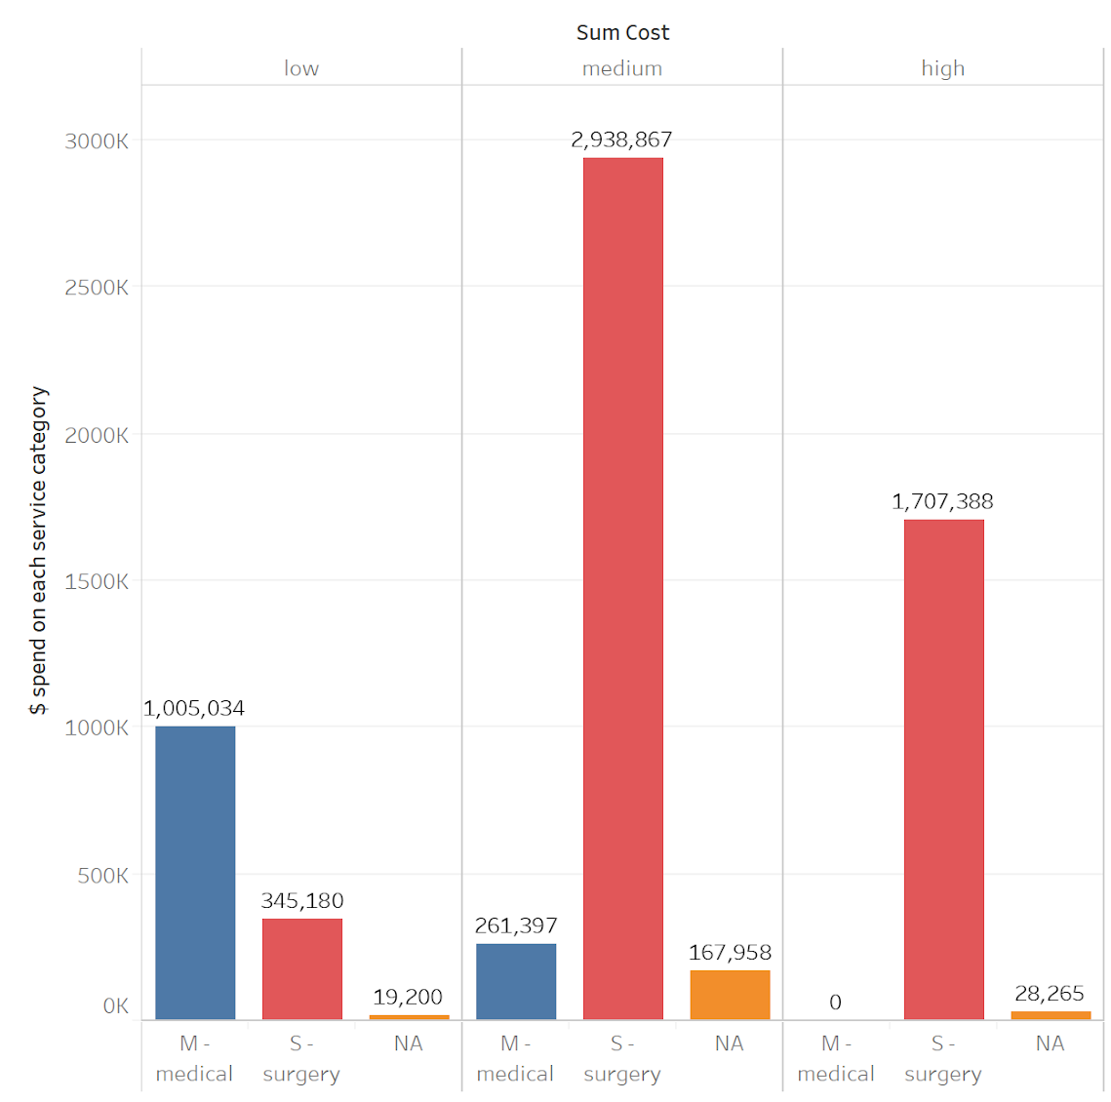
Service categories Cont. VS Clusters
Total costs of Medical services is the highest in the Low-cost cluster since it has much more number of DRGs than surgery.
Surgery costs much more than medical services in the medium-cost cluster.
In the high-cost cluster, almost all costs fall into the surgery service except one cost with no specific category.
Notes:
Insights: we could conclude that the number of surgery is an important factor that help with distinguishing clusters. The more surgery contains in the cluster, the higher the cost would be. This makes sense because surgery usually costs much more than a typical medical service, so the clusters with higher k-mean should include more surgery services.

Slide 10
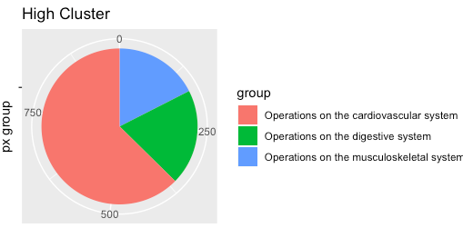
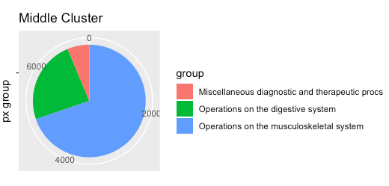
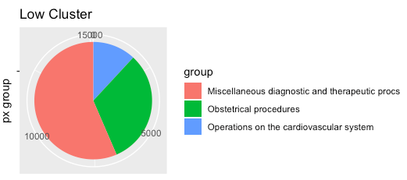
CCSPXGRP(Principle Procedure High Level Group) VS Clusters
High:
Operations,major on cardiovascular system
Medium:
Operations,major on musculoskeletal system
Low:
Miscellaneous diagnostic and therapeutic procs
Notes:
We hope to further confirm our assumption that medical/surgery type may have relationship with the cluster classification.
We merge our cluster table with the inpatient table and find the CCSPXGRP categories (CCS PX HIGH LEVEL GROUP)of three clusters. Then we keep the top three PX groups of each cluster for further comparison. From the pie graphs, we notice that High and Medium clusters have more operation PXs, however, high cluster concentrates on cardiovascular system while medium cluster concentrates on musculoskeletal system. In comparison, low cluster has fewer operations, the major PX group is Miscellaneous diagnostic and therapeutic procs.

Slide 11
Conclusion
Summary of Methods:
MDC Categories Analysis
MCC/CC Occurrence Rate Analysis
Service Categories Analysis
Principle Procedure High Level Group Analysis
Insights:
Operations On Major Parts -- High Cost
Operations On Minor Parts -- Medium Cost
Tiny Operations Or No Operations At All - Low Cost

